Slide 1
The Effect of Various Pollutants on Respiratory Health in New York City, Delhi, and Rio
Group 9
05/07/2026
Jackson Adame-Covey, Celine Aoun, and Audrija Bhattacharya

Slide 2
Outline
Background: 3 major metropolitans, long-COVID, and air pollution
Objectives: compare respiratory risk factors across metropolitans
Methods: Inclusion and exclusion criteria + search strings
Results: most prevalent air pollutants by location
Conclusion: future international policy implications

Slide 3
Intro
99% of world lives in conditions where WHO air quality guideline levels are not met → to 6.7 million premature deaths a year ⁵
Importance of respiratory health; 400 million Long-Covid ¹²
Mananga et al. examined the exposure effects of air pollutants on respiratory health symptoms ¹⁵
Oliveira et al. studied biofuel air pollutant characteristics in Brazil. ¹⁹
Neither were geographically comparative

Slide 4
Our Goal
Create a comparative review that builds off of previous research
Determine how some of the world’s most important areas are affected by air pollution
Specify which air pollutants pose the most risk to inform global policy

Slide 5
Research Question
What are the most common air pollutants that lead to upper respiratory tract infections and bronchial diseases in New York City, New Delhi, and Rio De Janeiro?

Slide 6
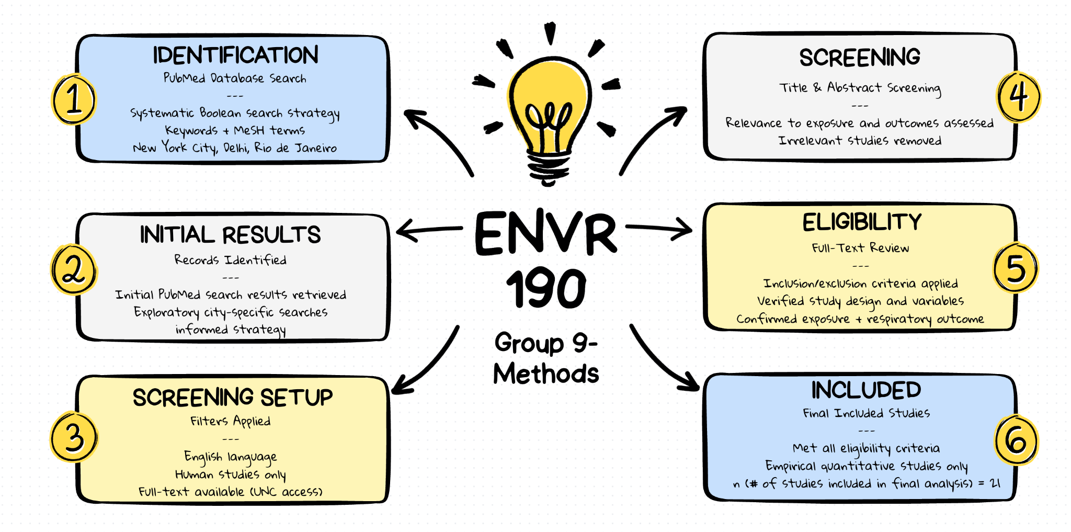
Methods

Slide 7
Results
Variable | n(%) (n= number of articles that contain information regarding the category, % = percentage of articles out of 15 total)
City
New York City | 6(40%)^{2, 7, 8, 9, 15, 18,}
Delhi | 5(33.33%)^{4, 6, 11, 16, 17}
Rio | 4(26.67%)^{1, 3, 10, 14}
Exposures
PM_{2.5} | 8(53.33%)^{1, 2, 4, 6, 8, 10, 11, 20}
CO | 6(40%)^{1, 3, 4, 10, 17, 20}
PM₁₀ | 6(40%)^{3, 4, 6, 11, 14, 16,}
NO_{x} | 5(33.33%)^{1, 3, 8, 17}

Slide 8
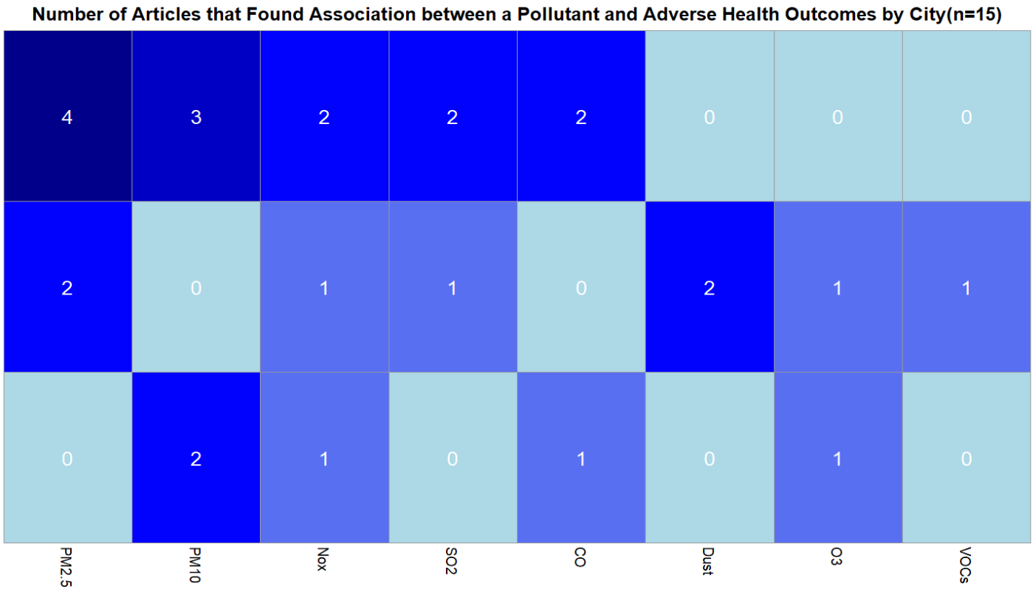


Results

Slide 9
Results
Most prevalent city in literature: New York City (6 articles)
Most prevalent pollutant studied in literature: PM_{2.5} (8 articles)
City with the most associations found between pollutants and negative health outcomes: Delhi (13 associations)
Pollutant with most association to negative health outcomes: PM_{2.5}(6 associations)
Least prevalent city in literature: Rio (4 articles)
City with least associations found between pollutants and negative health outcomes: Rio (5 associations)

Slide 10
Discussion
Uneven geographic distribution of research (NYC > Delhi > Rio).
PM2.5 is the most studied pollutant and shows strongest association with outcomes.
Lack of significant PM2.5 findings in Rio suggests possible research gap.
Public health would be advanced from further research.
Future work should include VOCs and dust as additional exposures in search.

Slide 11
Kelkar, H., Sharma, A. K. & Chaturvedi, S. Association of air pollution and lung function of young adult females in New Delhi. Journal of Health and Pollution 9, 190611 (2019).
Kim, H. & Bell, M. L. Air pollution and COVID-19 mortality in New York City. American Journal of Respiratory and Critical Care Medicine 204, 97–99 (2021).
Costa, A. F., Hoek, G., Brunekreef, B. & De Leon, A. C. M. P. Air Pollution and Deaths among Elderly Residents of São Paulo, Brazil: An Analysis of Mortality Displacement. Environmental Health Perspectives 125, 349–354 (2016).
Kumar, R. et al. Air pollution and its effects on emergency room visits in tertiary respiratory care centres in Delhi, India. Monaldi Archives for Chest Disease 94, (2023).
World Health Organization: WHO. Ambient (outdoor) air pollution. https://www.who.int/news-room/fact-sheets/detail/ambient-(outdoor)-air-quality-and-health (2024).
Salvi, S. S. et al. Association between air pollution, body mass index, respiratory symptoms, and asthma among adolescent school children living in Delhi, India. Lung India 38, 408–415 (2021).
Kwon, S. et al. Blood eosinophils and World Trade Center Exposure predict surgery in chronic rhinosinusitis. a 13.5-Year longitudinal study. Annals of the American Thoracic Society 13, 1253–1261 (2016).
Feathers, A. et al. Crohn’s Disease mortality and ambient air pollution in New York City. Inflammatory Bowel Diseases 30, 1732–1739 (2023).
Madani, N. A., Jones, L. E. & Carpenter, D. O. Different volatile organic compounds in local point source air pollution pose distinctive elevated risks for respiratory disease-associated emergency room visits. Chemosphere 344, 140403 (2023).
Kuschnir, F. C. & Da Cunha, A. J. L. A. Environmental and socio‐demographic factors associated to asthma in adolescents in Rio de Janeiro, Brazil. Pediatric Allergy and Immunology 18, 142–148 (2006).
Dutta, A. & Jinsart, W. Air pollution in Delhi, India: It’s status and association with respiratory diseases. PLoS ONE 17, e0274444 (2022).
Al-Aly, Z. et al. Long COVID science, research and policy. Nature Medicine 30, 2148–2164 (2024).
Population by country (2026) - Worldometer. Worldometer https://www.worldometers.info/world-population/population-by-country/.
Cortes, T. R., Silveira, I. H., De Oliveira, B. F. A., Bell, M. L. & Junger, W. L. Short-term association between ambient air pollution and cardio-respiratory mortality in Rio de Janeiro, Brazil. PLoS ONE 18, e0281499 (2023).
Mananga, E. S., Lopez, E., Diop, A., Dongomale, P. J. & Diane, F. The impact of the air pollution on health in New York City. Journal of Public Health Research 12, 22799036231205870 (2023).
Romieu, I. et al. Multicity study of air pollution and mortality in Latin America (the ESCALA study). Res Rep Health Eff Inst 5–86 (2012).
Aneja, V. P. et al. Measurements and analysis of criteria pollutants in New Delhi, India. Environment International 27, 35–42 (2001).
Antao, V. et al. 9/11 Residential Exposures: The impact of World Trade Center dust on respiratory outcomes of Lower Manhattan residents. International Journal of Environmental Research and Public Health 16, 798 (2019).
Oliveira, B. F. A. de, Ignotti, E. & Hacon, S. S. A systematic review of the physical and chemical characteristics of pollutants from biomass burning and combustion of fossil fuels and health effects in Brazil. Cad. Saúde Pública 27, 1678–1698 (2011)
Titus, A. R. et al. A matched analysis of the association between federally mandated Smoke-Free housing policies and health outcomes among Medicaid-Enrolled children in subsidized Housing, New York City, 2015–2019. American Journal of Epidemiology 192, 25–33 (2022).
References

Slide 12
Q&A

